Slide 1
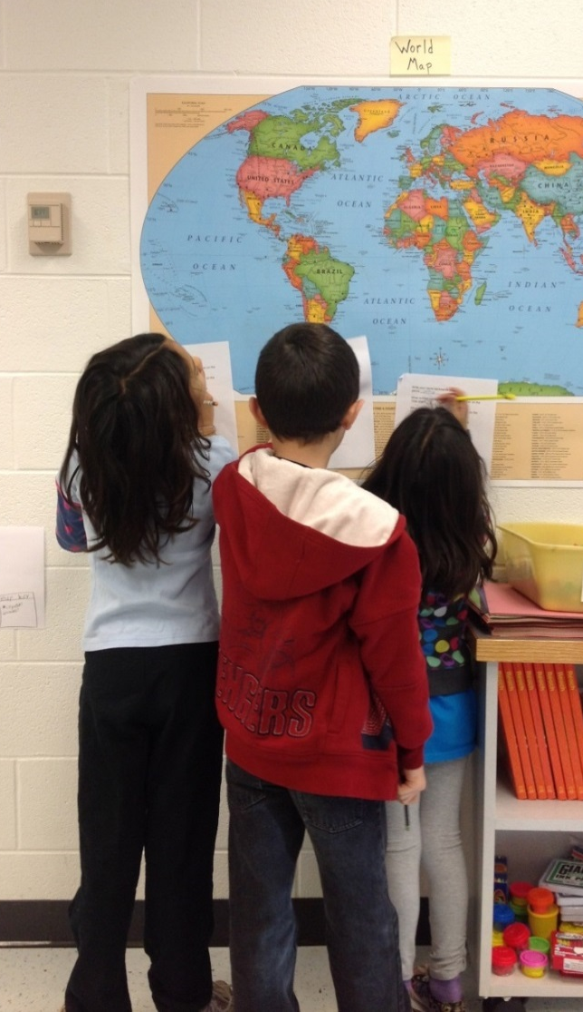
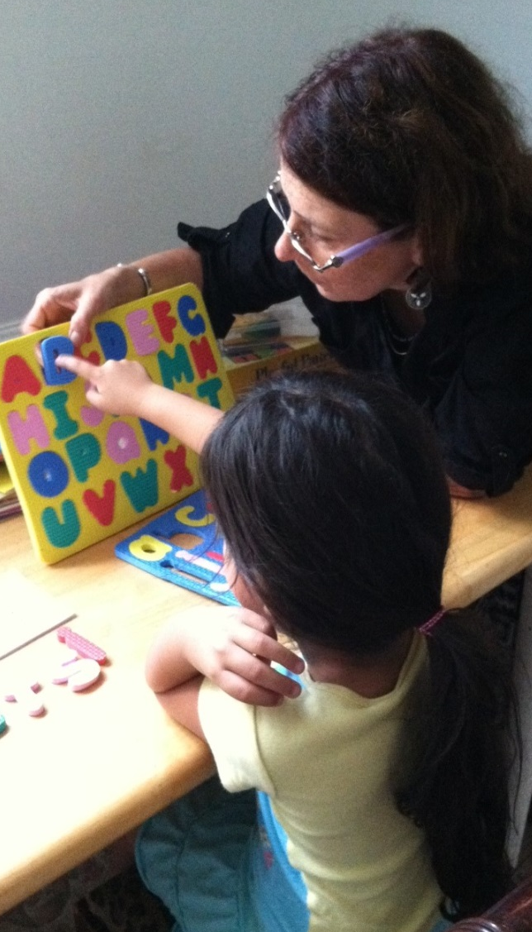
Planning to Expand World Languages in Albemarle County
Albemarle County
Public Schools
Department of Instruction
December, 2014

Slide 2

Purpose
To share and receive feedback on a plan for expanding world languages in elementary and middle schools.

Slide 3
Agenda
Item | Time
Review of Plan to Expand World Languages | 6:50-7:05
Clarifying questions and feedback from the board | 7:05-7:25
Notes:
Causal as well as associative evidence. So we know that learning languages helps overall academic achievement and cognitive processes. But do we have specific information on how a child’s proficiency in their native language helps them learn English in schoo?

Slide 4


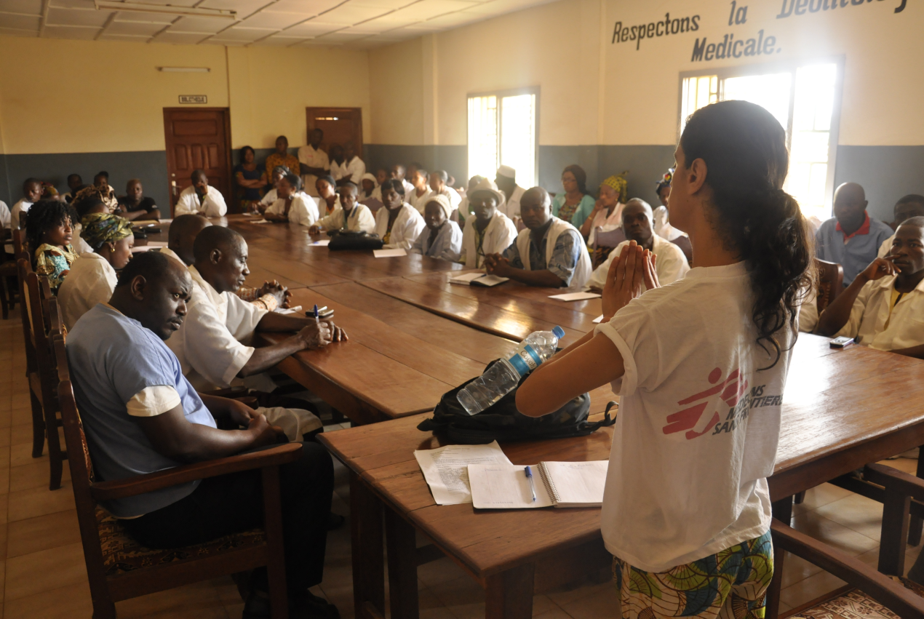


Slide 5

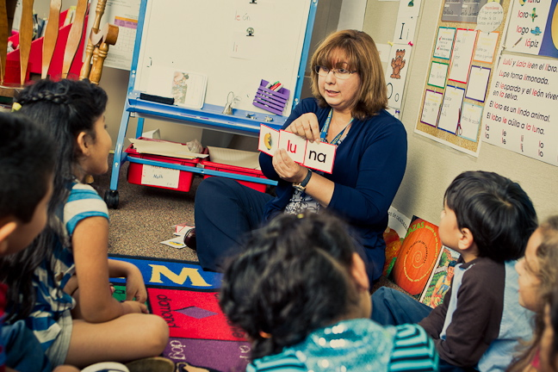
Current State: Elementary Schools
Cale offers both immersion and pull-out classes in Spanish for all students K-2.
Agnor-Hurt and Stony Point are piloting the use of existing staff to teach Spanish in kindergarten.
Meriwether Lewis has offered after-school programs in Chinese, French, and Spanish.
Baker-Butler, Murray and Brownsville have offered language courses during and after school with volunteers or Rosetta Stone.

Slide 6

Sequential Expansion
in Elementary Schools
2-3 Elementary Schools each year will begin world languages programs.
These schools will be selected based on a readiness assessment presented to the Department of Instruction.
A budget initiative for schools that meet these requirements will be submitted to the board.

Slide 7
The Readiness Assessment
This readiness assessment will include the following:
  Selection of a language based on languages of staff and students, input from parents, other languages offered in the feeder pattern, and input from the business community.
  Selection of program model (immersion vs. pull-out) based on school size, mobility, and natural turnover in teachers.
  Plan for professional development and resource support for staff.
Notes:
The readiness assessment will provide schools a framework for determining preparation for world languages expansion.

Slide 8
Middle School Planning
  Middle Schools will add a 6th grade conversation course in world languages.
  7th grade will begin to offer Level I of world languages.
  8th grade will offer Level II of world languages.
  The above would require redesigning the middle school schedule and possibly discontinuing the practice of double blocking students in language arts and/or math for many students.
  Language study in middle school will be opt-out, rather than opt-in.
Notes:
The readiness assessment will provide schools a framework for determining preparation for world languages expansion.

Slide 9
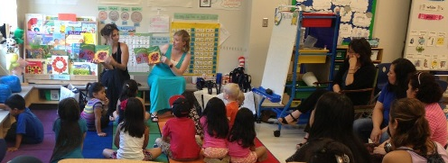
Clarifying Questions?
Expanding Opportunities: Defining a Robust World Languages Program

Slide 10
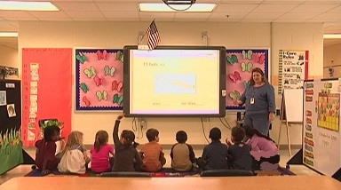
Expanding Opportunities
for Our Community’s Children
Multilingualism
Creativity Communication Critical Thinking Collaboration

